Slide 1
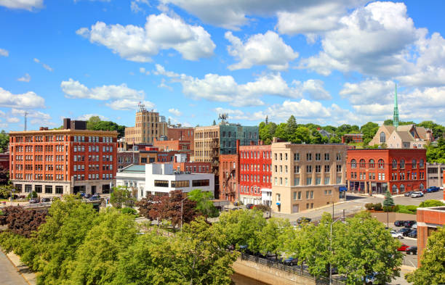
Affordable Housing in Bangor
Robyn Stanicki
Community Development Officer
robyn.Stanicki@bangormaine.gov

Slide 2

CITY OF BANGOR, MAINE
Urban City Pop. 31,065
Service Center to 21 Communities
Shaped by 19th- century logging industry
Home of Hannibal Hamlin, Dorothea Dix, Stephen King,
And Paul Bunyan

Slide 3
Bangor’s Affordable Housing Context
The City of Bangor is experiencing a severe shortage of housing. Over the last five years, the City has worked to define and assess the issues compounded by and contributing to social problems.
Capacity – The City has an overall housing shortage of 1,900 units.
Typology – Evolving household composition shows a mismatch between the size and type of housing needed, with more studios and one bedroom rentals recommended as a top priority
Affordability and Community Need – Housing affordability, particularly rental costs, are more unaffordable than any other urban Maine city.

Slide 4
Bangor’s Affordable Housing Context
The City of Bangor is experiencing a severe shortage of housing. Over the last five years, the City has worked to define and assess the issues compounded by and contributing to social problems.
Residential Ownership and Market Health – More rental housing, including mobile home parks, are being bought by investors, reducing overall housing supply in the affordable market.
Housing Quality – The majority of Bangor’s housing is more than 50 years old, is concentrated in the urban core and also in neighborhoods with residents that are predominantly LMI.
Homelessness – The City is experiencing a crisis such has never been seen. Our homeless population per capita is equal to that of Houston Texas. Supportive housing is a critical need.

Slide 5
Bangor’s Affordable Housing Context
2020-2022 – Addressing Political and Regulatory Barriers to Housing Production, Preservation, and Rehabilitation
Dimensional Requirements
November 2020: Reduced the minimum lot size and other dimensional controls (e.g. setbacks) in three urban residential zones.
June 2021: Relaxed dimensional controls for the primary multi-family zone in the City (Multifamily & Service District), including reducing the minimum lot size per unit, reducing setbacks, allowing increased height along arterial streets, and reducing parking minimums. This zone is primarily located in the dense, urban core of the City, so the smaller lot sizes have enabled additional units to be added to buildings where they would not have been before.

Slide 6
Bangor’s Affordable Housing Context
2020-2022 – Addressing Political and Regulatory Barriers to Housing Production, Preservation, and Rehabilitation
Parking Requirements
November 2019 and June 2022 – Relaxed requirements for driveway buffers and the use of driveway area to meet parking requirements for residential zones
March 2021 – Allowance for shared parking on or off-site for multiple uses
June 2024: Reduced parking minimums for residential buildings:
Reduced from 1.5 spaces to 1 per dwelling unit.
According to the new rule, other types of residential living situations, such as boarding homes, subsidized senior housing, and congregate housing, have even lower parking requirements.

Slide 7
Bangor’s Affordable Housing Context
2020-2022 – Addressing Political and Regulatory Barriers to Housing Production, Preservation, and Rehabilitation
Housing Typology
December 2019 – Accessory Dwelling Units allowance
June 2022: Adopted an ordinance to allow boarding homes in additional zones.
October 2022 and 2023: Ordinances creating the use of permanent supportive housing, defined this use and added it as a conditional use to the multiple zones.
October 2022: Ordinance creating a new use of “tiny home” parks and allowing these by right in multiple zones.
March 2024: Defined the use of “co-living” (dormitories) to allow this use in multiple zones.
August 2023 and 2024: Revised the requirements for manufactured/mobile home parks to be less restrictive and in compliance with State law, as well as to allow them in additional zones. The ordinance allows manufactured homes on any lot where single-family homes are allowed.

Slide 8
Bangor’s Affordable Housing Context
2020-2022 – Addressing Political and Regulatory Barriers to Housing Production, Preservation, and Rehabilitation
Density
June 2023: Adopted an ordinance to allow multi-family residential and mixed commercial-residential uses by right in two primary commercial zones – Shopping & Personal Service District (S&PS) and General Commercial & Service District (GC&S).
September 2023: Increased the number of units allowed on undeveloped lots to 4
September 2023 and April 2024: Reduced restrictions on ADUs to eliminate parking minimums and to increase flexibility for placement on a lot.
August 2024: Revised the Code to eliminate the requirement for renovation of a multi-unit building, or the addition of a unit that results in a building having 3 or more units, to receive a Land Development Permit.

Slide 9
Bangor’s Affordable Housing Context
2020-2022 – Addressing Political and Regulatory Barriers to Housing Production, Preservation, and Rehabilitation
Land Use Changes
October 2023: The City’s Code of Ordinances was updated to clarify the definition of emergency shelters and to allow this use in the Government & Institutional Service District (G&ISD) with stipulations around siting and layout.
October 2023: The City adopted regulations and limits on short-term rentals to ensure preservation of the supply of long-term rental housing.

Slide 10
Affordable Housing – Theory of Change
Bangor’s relationship to housing development has gone from passive to proactive to encourage the type of housing that the City Needs
Regional Responsibility and Interdependence: As the largest population center in Penobscot County and a primary service hub for much of central and eastern Maine, Bangor’s housing market is directly shaped by county-level dynamics and regional service catchment realities. When surrounding municipalities lack sufficient housing options, particularly affordable, workforce, supportive, and senior housing, the need is effectively displaced into Bangor. Concentrating the responsibility for affordable housing, supportive housing, and emergency shelter within Bangor places an unsustainable burden on the city’s neighborhoods, infrastructure, and public resources.

Slide 11
Affordable Housing – Theory of Change
Regulatory and Programmatic Investments which align with the Consolidated Plan are grounded in a principle framework to anchor policy action
Affordability as Long-Term Infrastructure: Permanently affordable housing can strengthen neighborhood stability and resident outcomes. Long-term affordability reduces displacement, supports wealth-building opportunities for lower-income households where appropriate, and creates predictability for residents, service providers, and employers. These benefits are especially important in a regional service center like Bangor, where stable housing underpins workforce retention, access to care, and community well-being.
Notes:
The City of Bangor has been participating in this program since the 1980s

Slide 12
Affordable Housing – Theory of Change
Regulatory and Programmatic Investments which align with the Consolidated Plan are grounded in a principle framework to anchor policy action
Market Stewardship and Balance: In recent years, shifts in ownership patterns, investment behavior, and housing demand have altered the local housing landscape. Increased consolidation by large-scale or absentee owners, speculative investment practices, and short-term financial extraction can reduce housing stability, limit consumer choice, and place upward pressure on rents and prices.
Transition from smaller landlord operators to large corporate management – while appearing to offer efficiency or stability, often results in more distant ownership, reduced responsiveness to tenants, and management practices that prioritize scale over relationships. Left unaddressed, these trends can weaken neighborhood cohesion and undermine the long-term availability of housing for local residents.

Slide 13
Changing the housing system
Removing Regulatory Barriers
Adjusted Zoning standards to better accommodate infill housing, reducing regulatory friction for smaller-scale residential projects
Minimum lot sizes
Parking requirements
More uses (tiny home parks, multifamily in more zones, boardinghouses, co-living, PSH)
Higher density
Eliminated Procedural Barriers to address development risk and financing costs
Pre-approved architectural plans
Increased by-right development opportunities (ADUs)

Slide 14


Changing the housing system
Increasing density to build not just more housing, but the right kind of housing
Affordable Housing Density Bonus: Provides developers with relaxed requirements with an agreement to create or preserve housing that is affordable to households earning less than 80% AMI
Any parcel within the City’s growth boundary
Up to 4 units per undeveloped SF parcel
Bonus units per parcel (base density)
Affordable Housing Covenant (30 years)
Multiplier effect on increased density allowances
( ) X 2.5
Lot Size
Base Density (ft² per unit)
Bonus Capacity =

Slide 15
Changing the housing system
AFFORDABLE HOUSING DENSITY BONUS PROGRAM
“Affordable Rental” defined as 30% of income, 51% occupation by 80% LMI households at lease up
“Affordable Ownership” defined as 30% of income, 51% occupation – Includes households earning up to 120% AMI
Long-term tenants are not penalized for exceeding income

Slide 16
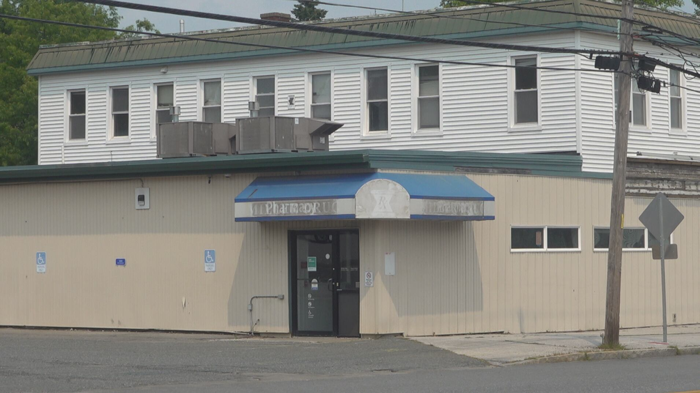
Changing the housing system
Bangor’s relationship to housing development has gone from passive to proactive to encourage the type of housing that the City Needs
Miller Drug - .56 ac parcel
Includes 1,800 ft² of retail space and 4 apartments upstairs
Franks Bakery bought the building in 2025 and used the Density Bonus for Development: 2 units market rate, 8 units affordable housing.
Minimum lot area: 10,000 ft². Allowance of 1 to 4 Dwelling Units
Affordable Housing Density Bonus, 5,000 ft² for first 5 units, plus 1,000 ft² for each additional unit up to 10. Calculation: 5,000 + (1,000 x 5) + 10,000 = 20,000ft² required for 10 units. OR
Base Density of 4 multiplied by 2.5 = 10

Slide 17
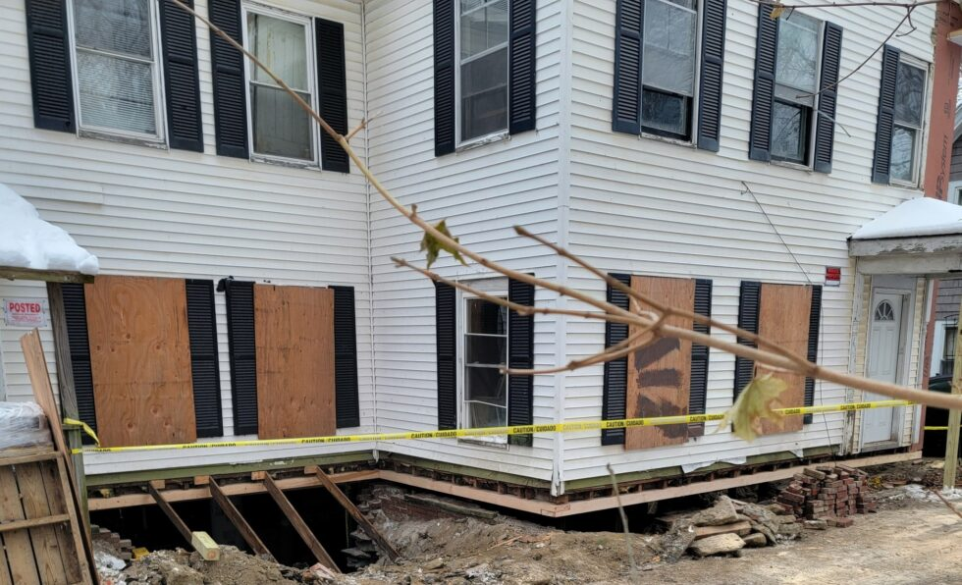
Changing the housing system
Bangor’s relationship to housing development has gone from passive to proactive to encourage the type of housing that the City Needs
Design Wall Housing – Supported Housing for formerly homeless households.
Created 4 units on a .15 ac, 6,534 ft parcel with a placard
All leased to families transitioning from homelessness, with services and support provided by mental health professionals
Minimum lot area: 5,000 ft² for one to two units, and 10,000 ft² for four units
Affordable Housing Density Bonus, 1,000 ft² for each additional unit up to 10.
Calculation: 5,000 ft² for first 5 units, or 6,534 / 1000 = 6 allowable units OR
Base density of 2.61, multiplied by 2.5 = 6.534 total units

Slide 18
Changing the housing system
QUALITY HOUSING PROVIDER PROGRAM
Quality Housing Provider Program combined a voluntary rental registry with Landlord Incentives, including:
Pathways to zone changes and waivers to address “hidden units” and increased touchpoints with City staff to resolve issues
Tenant Support and Resources
Dedicated revolving loan fund
Tenant Rights and Responsibilities Ordinance

Slide 19
Takeaways
Encouraging More Affordable, Right Type of Housing
Discouraging Extractive and Speculative Ownership
Addressing Regulatory Barriers in Zoning
Investing in Priority Projects
Notes:
Grantees such as Bangor are tasked with ensuring that CDBG funds are used to further three main objectives.

